Slide 1

Complete Course
27010
Thapa Technical
SUBSCRIBE
https://thapatechnical.shop

Slide 2


COURSE TOPICS
MONDODB
BASICS
ADVANCED
PROJECTS
Introduction to MongoDB NoSQL Vs SQL
JSON Vs BSON
Managing DB & Collections Advanced CRUD Operations Comparison Operators Cursors in MongoDB
Logical Operators
$expr & Elements Operator Projection & Relationship Embedded Documents
Introduction to Indexes Creating and Managing Index
Understanding the Aggregation Framework Introduction to Aggregation
Basic Aggregation Operations Combining Aggregation Stages Aggregation Operators and Expressions
Pipeline Stages
($match, $project, $group, $sort,
$limit, $unwind, $filter, $skip etc)
Project 1:
Working with MongoDB Node.js Driver (How to perform CRUD operations In real life project )
Project 2:
Working with Mongoose & Node.js
Thapa Technical
SUBSCRIBE
https://thapatechnical.shop

Slide 3
COURSE TOPICS
MONDODB
DataBase sevices , to deploy mongo db and access them created by mongoDb.
MONGODB ATLAS MONGODB COMPASS
Thapa Technical
SUBSCRIBE
https://thapatechnical.shop

Slide 4
Introduction to MongoDB
What is MongoDB?
NoSQL vs SQL
Thapa Technical
SUBSCRIBE
https://thapatechnical.shop

Slide 5

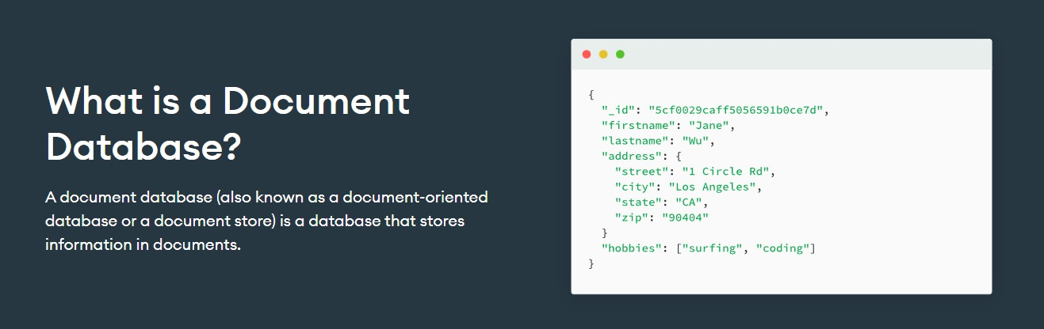
What is MongoDB?
MongoDB is an open-source, document-oriented NoSQL database management system.
Designed for flexibility, scalability, and performance in handling
unstructured or semi-structured data

Slide 6

More About MongoDB
10gen
It was created by a company called 10gen, which is now known as MongoDB, Inc. The company was founded by Eliot Horowitz and Dwight Merriman in 2007. The first version of MongoDB was released in 2009.
Thapa Technical
SUBSCRIBE
https://thapatechnical.shop

Slide 7

Clusters in MongoDB
In MongoDB, a cluster refers to a group of interconnected servers (nodes) that work together to store and manage data.
Thapa Technical
SUBSCRIBE
https://thapatechnical.shop

Slide 8
More About MongoDB
HUMONGOUS
HUMONGOUS
Thapa Technical
SUBSCRIBE
https://thapatechnical.shop

Slide 9

MongoDB(NOSQL
SQL
)
SQL databases are relational databases.
They use structured tables to store data in rows and columns.
Suitable for applications with well-defined schemas and fixed data structures.
E-commerce Platform, HR Management etc Examples: MySQL, PostgreSQL, Oracle.
NoSQL databases are non-relational databases.
They provide flexibility in data storage, allowing varied data types and structures.
Ideal for applications with dynamic or evolving data models.
CMS, Social Media Platforms, Gaming etc Examples: MongoDB, Cassandra, Redis.
Thapa Technical
SUBSCRIBE
https://thapatechnical.shop

Slide 10
Some basic differences
SQL | NOSQL
Database | Database
Tables | Collections
Rows | Document

Slide 11
Datatypes : // 1: Double // 2: String // 3: Object // 4: Array // 5: Binary data // 6: Undefined // 7: Object id // 8: Boolean // 9: Date // 10: Null // 11: Regular expression // 12: JavaScript code // 13: Symbol // 14: JavaScript code with scope // 17: 64-bit integer

Slide 12
SQL
Columns
student_id | first_name | last_name | age | grade
1 | Vinod | Thapa | 16 | 11
2 | Thapa | Technical | 17 | 12
Table: Students
Rows
subject_id | subject_name
1 | Mathematics
2 | Computer
Table: Subjects
student_id | subject_id | marks
1 | 1 | 100
2 | 2 | 99
Table: Grades
Thapa Technical
SUBSCRIBE
https://thapatechnical.shop

Slide 13




NOSQL
(MONGODB)
[
{
"_id": "1", "first_name": “Vinod", "last_name": “Thapa", "age": 16,
"grade": 11,
"subjects": [
{ "subject_name": "Mathematics", "marks": 100 },
{ "subject_name": "Computer", "marks": 100 }
Embedded documents
]
Collection: Students 2- documents
},
{
"_id": "2", "first_name": "Thapa",
"last_name": "Technical",
"age": 17,
"grade": 12,
“extra": ‘sport captain’, "subjects": [
{ "subject_name": "Mathematics", "marks": 100 },
{ "subject_name": "Computer", "marks": 100 }
]
Thapa Technical
SUBSCRIBE
}
]
https://thapatechnical.shop

Slide 14
MongoDB
Terminologies
Database
collections
Students
Teachers
Products
Schema less
Document
{ } | "name": “Vinod", "age": 30, "address": { "city": "New York", } |  | { } | "name": “Thapa", "age": 30, "address": { "city": “Pokhara", } |  | { } | "name": “Binamra", "address": { "city": “Kathmandu" } |  | { } | "name": “Mobile", “stock": 30 |  | { } | “name": “Laptop", “stock": 10, “comments": { “user1": “Nice", }
Thapa Technical
SUBSCRIBE
https://thapatechnical.shop

Slide 15














Key Features of MongoDB
Flexible Schema Design
Scalability and Performance
Document- Oriented Storage
Dynamic Queries
Aggregation Framework
Open Source and Community
MongoDB allows dynamic, schema-less data structures.
Easily accommodate changing data requirements.
Horizontal scaling supports large datasets and high traffic.
Optimized read and write operations for fast performance.
Data is stored in flexible, JSON- like BSON documents.
Self-contained units with rich data types and nested arrays.
Rich query language with support for complex queries.
Utilize indexes to speed up query execution.
Perform advanced data transformations and analysis.
Process data using multiple pipeline stages.
MongoDB is open-source with a vibrant community.
Regular updates, improvements, and support.
Thapa Technical
SUBSCRIBE
https://thapatechnical.shop

Slide 16
MongoDB Data
Atlas Database
mongoShell
 | MongoDB Compass
Thapa Technical
SUBSCRIBE
https://thapatechnical.shop

Slide 17
How MongoDB Works?
Frontend
Backend
Database
MongoDB Server
WiredTiger & MMAPV1 (❌)
Node.js
Storage Engine
Express.js
HTML, CSS, JS
Read & Write Data files
Next.js
React.js, Next.js
Python
Thapa Technical
SUBSCRIBE
https://thapatechnical.shop

Slide 18
JSON Vs BSON
In MongoDB, we write in JSON format only but behind the scene data is stored in BSON (Binary JSON) format, a binary representation of JSON.
By utilizing BSON, MongoDB can achieve higher read and write speeds, reduced storage requirements, and improved data manipulation capabilities, making it well-suited for handling large and complex datasets while maintaining performance efficiency.
Thapa Technical
SUBSCRIBE
https://thapatechnical.shop

Slide 19
JSON vs
BSON
BSON
JSON
Not Easy to Read
Easy to Read & Write
\x1e\x00\x00\x00
\x02
name\x00
\x04\x00\x00\x00Thapa\x00
\x10 age\x00
\x1e\x00\x00\x00\x00\x00\x00\x00
\x08 isStudent\x00
\x00
\x04 scores\x00
\x05\x00\x00\x00\x03\x00\x00\x00
\x10
\x00\x00\x00\x00\x00\x00\x00\x00
\x10
\x00\x00\x00\x00\x00\x00\x00\x00
\x10
\x00\x00\x00\x00\x00\x00\x00\x00
{
"name": "Thapa", "age": 29, "isStudent": false, "scores": [92, 108], "address": {
"city": "Pokhara"
}
}
Thapa Technical
SUBSCRIBE
https://thapatechnical.shop

Slide 20
Installing MongoDB
https://www.mongodb.com/try/download/community
https://www.mongodb.com/try/download/shell https://www.mongodb.com/try/download/database-tools
Thapa Technical
SUBSCRIBE
https://thapatechnical.shop

Slide 21






BSON in MongoDB
Binary JSON Format: BSON, Binary JSON, is used in MongoDB for data storage and transmission.
Efficient Storage: Designed for efficient data storage and transmission in MongoDB.
Diverse Data Types: Supports a wider range of data types, including Binary, Date, and Regular Expression.
Compact C Fast: BSON's binary format is more compact, leading to smaller storage and faster processing.
Native to MongoDB: MongoDB stores data in BSON format, ensuring seamless integration.
Performance Boost: Faster serialization improves data access and manipulation speed.
Thapa Technical
SUBSCRIBE
https://thapatechnical.shop

Slide 22
Managing Databases in MongoDB
Creating / Deleting Databases
Creating / Deleting Collections
Thapa Technical
SUBSCRIBE
https://thapatechnical.shop

Slide 23
Main concepts and commands

Slide 24
Managing Databases and Collections
show dbs;
use <database-name>;
db.dropDatabase();
Show all databases;
Select a particular database
First select that database and then this command to delete a database
show collections;
db.createCollection('<collection-name>’);
db.<collection-name>.drop();
Thapa Technical
SUBSCRIBE
https://thapatechnical.shop

Slide 25
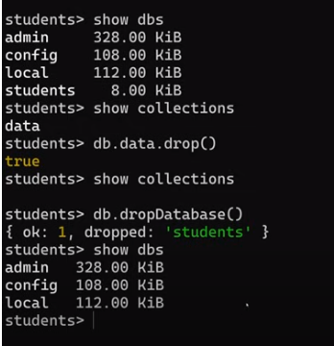

Slide 26

Insert Operation in MongoDB
Inserting Documents in MongoDB
When to use Quotes and when not to? Ordered and Unordered Inserts
Case Sensitivity in MongoDB
Thapa Technical
SUBSCRIBE
https://thapatechnical.shop

Slide 27
Inserting Documents in MongoDB
db.<collection-name>.insertOne({ field1: value1,
field2: value2,
...
});
db.<collection-name>.insertMany([
{ field1: value1, field2: value2, ... },
{ field1: value1, field2: value2, ... },
// ...
]);
Thapa Technical
SUBSCRIBE
https://thapatechnical.shop

Slide 28
MONGOD
INSERTONE
InsertOne
Before
After
db.Students.insertOne(
{
name: “Binamra",
age: 20,
}
);
[
[
{
{
name: "Vinod",
name: "Vinod",
age: 29,
age: 29,
},
{
name: “Binamra", age: 20,
}
}
]
]
Thapa Technical
SUBSCRIBE
https://thapatechnical.shop

Slide 29
MONGOD
INSERTMANY
After
InsertMany
Before
[
{
db.Students.insertMany([
{
name: "Binamra", age: 20,
},
{
name: "Thapa",
age: 21,
},
]);
name: "Vinod",
age: 29,
},
{
name: “Binamra",
age: 20,
},
{
name: "Thapa", age: 21,
}
[
{
name: "Vinod",
age: 29,
}
]
]
Thapa Technical
SUBSCRIBE
https://thapatechnical.shop

Slide 30
When to use Quotes and when not to?
Special Characters
If a field name contains special characters or spaces, or starts with
a numeric digit, using quotes is necessary.
Reserved Words
If a field name is a reserved keyword in MongoDB, use quotes to distinguish it from the reserved keyword.
Thapa Technical
SUBSCRIBE
https://thapatechnical.shop

Slide 31
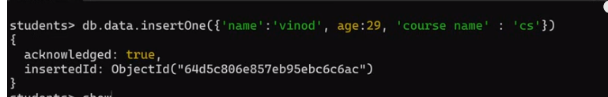
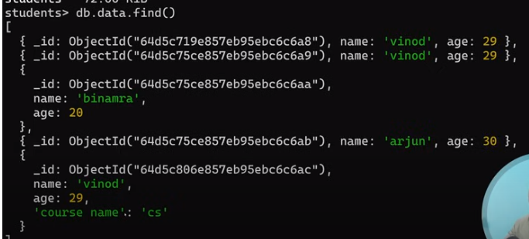

Slide 32
Ordered and Unordered Inserts
When executing bulk write operations, "ordered" and "unordered" determine the batch behavior.
Ordered Inserts
Default behavior is ordered, where MongoDB stops on the first error.
db.<collection-name>.insertMany([ doc1, doc2, ... ]);
Unordered Inserts
When executing bulk write operations with unordered flag, MongoDB continues processing after encountering an error.
db.<collection-name>.insertMany([ doc1, doc2, ... ], { ordered: false });
Thapa Technical
SUBSCRIBE
https://thapatechnical.shop

Slide 33
$Ordered Inserts
Documents Before the wrong one will be inserted & after the one with error will not.
 | {Correct Doc. 1}
 | {Wrong Doc. 2}
 | {Correct Doc. 1}
 | {Correct Doc. 3}
Very nicely explained at 59:25 in the video
https://www.youtube.com/watch?v=rU9ZODw5yvU&t=59m25s
Thapa Technical
SUBSCRIBE
https://thapatechnical.shop

Slide 34
$Ordered = false
Documents before the one with an error will be inserted, and the documents after the one with an error will also be inserted. Only the document with the error will not be inserted.
 | {Correct Doc. 1}
 | {Correct Doc. 1}
 | {Wrong Doc. 2}
 | {Correct Doc. 3}
 | {Correct Doc. 3}
 | {Correct Doc. 4}
 | {Correct Doc. 4}
Thapa Technical
SUBSCRIBE
https://thapatechnical.shop

Slide 35
Case Sensitivity in MongoDB
Collection names are case-sensitive.
Field names within documents are also case-sensitive.
db.Product.insertOne({ | name: | 'thapa', | age: | 30 | });
db.product.insertOne({ | name: | 'thapa', | age: | 30 | });
Product and product are two different collections .
Thapa Technical
SUBSCRIBE
https://thapatechnical.shop

Slide 36
Read Operations in MongoDB
Inserting Documents in MongoDB
Ordered and Unordered Inserts
Case Sensitivity in MongoDB
Comparison Operators Logical Operators Cursors in MongoDB
Thapa Technical
SUBSCRIBE
https://thapatechnical.shop

Slide 37
Finding Documents in MongoDB
find()
db.collection_name.find({ key: value })
findOne()
db.collection_name.findOne({ key: value })
Thapa Technical
SUBSCRIBE
https://thapatechnical.shop

Slide 38
Importing JSON in MongoDB
mongoimport | jsonfile.json | –d | database_name –c | collection_name
mongoimport | products.json | -d | shop -c products
mongoimport | products.json | -d | shop -c products | --jsonArray
Here, --jsonArray accepts the import of data expressed with multiple MongoDB documents within a single JSON array.
Limited to imports of 16 MB or smaller.
https://www.youtube.com/watch?v=rU9ZODw5yvU&t=1h10m13s
Thapa Technical
SUBSCRIBE
https://thapatechnical.shop

Slide 39
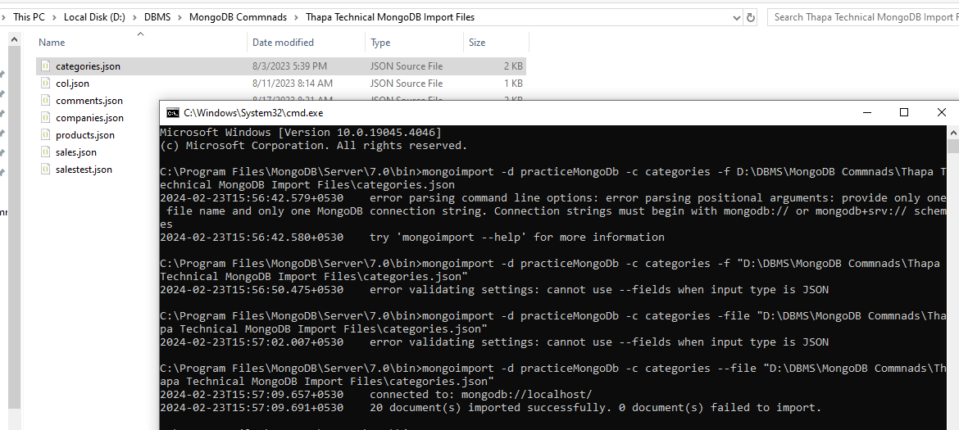

Slide 40
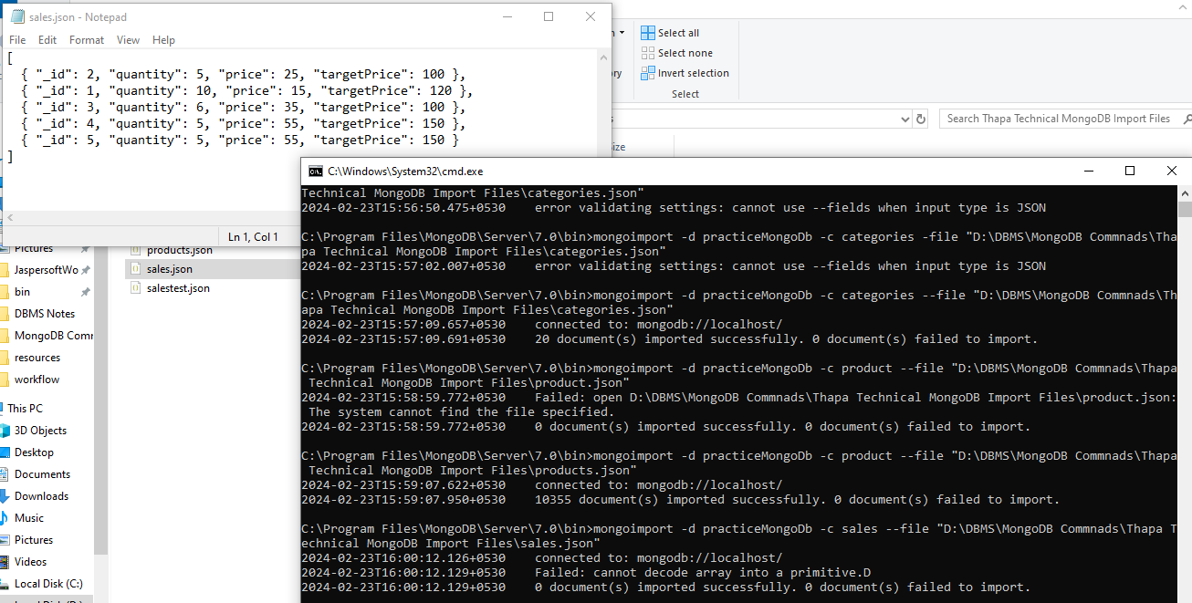
Array of data

Slide 41
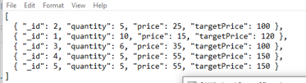
Array of data

Slide 42









Comparison Operators
$eq
$ne
$gt
$gte
$lt
$lte
$in
$nin
db.products.find({ 'price': { $eq: 699 } });
//for all it will work except $in and $nin
db.category.find({ price: { $in: [249, 129, 39] } });
// $in and $nin will takes array
Thapa Technical
SUBSCRIBE
https://thapatechnical.shop

Slide 43
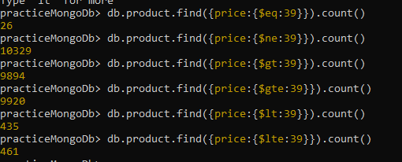
db.product.find({price:{$eq:39}})
db.product.find({price:{$ne:39}})
To find only the count just write
3. db.product.find({price:{$eq:39}}).count()

Slide 44
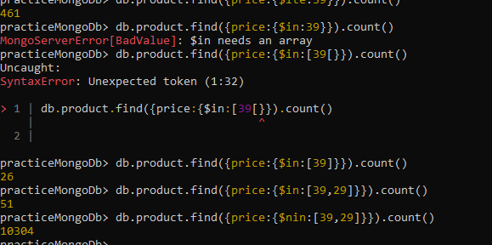
$in and $nin will takes array

Slide 45




Introduction to Cursors
Cursors in MongoDB are used to efficiently retrieve large result sets from queries, providing control over the data retrieval process.
MongoDB retrieves query results in batches using
cursors.
Cursors are a pointer to the result set on the server. Cursors are used to iterate through query results.
MongoDB retrieves query results in batches, not all at once.
Default batch size is usually 101 documents.
This improves memory efficiency and network usage.
Automatic Batching
Thapa Technical
SUBSCRIBE
https://thapatechnical.shop

Slide 46




Cursor Methods
count()
limit()
skip()
sort()
db.products.find({ price: { $gt: 250 } }).count(); //total no of objects
db.products.find({ price: { $gt: 250 } }).limit(5); // limit the no. of objects
db.products.find({ price: { $gt: 250 } }).limit(5).skip(2);
//first skip and then limit the no. of objects
db.products.find({ price: { $gt: 1250 } }'.limit(3).sort({ price: 1 });
(1) for ascending and (-1) for descending

Slide 47
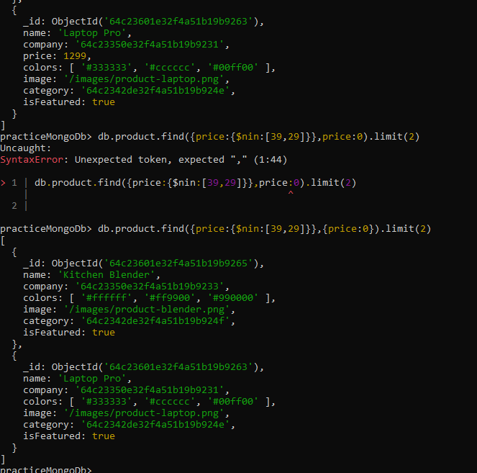
First {filtering condition},
Second for projects
0 for no
1 for yes

Slide 48
D:\DBMS\MongoDB Commnads\mongo_thapa_course folder we can find lot of questions and answer for those question too. Do try ……………..

Slide 49


Cursor Methods (Caveats)
Performance Implications
Use with Caution
skip() can be inefficient for large offsets.
Using sort() on large result
sets may impact performance.
Be cautious when using limit() and skip() on large collections.
Consider using indexing to optimize query performance.
Thapa Technical
SUBSCRIBE
https://thapatechnical.shop

Slide 50




Logical Operators
$and
$or
$not
$nor
{ $and: [ { condition1 }, { condition2 }, ... ]
//array of conditions for $and , $or , $nor
{ field: { $not: { operator: value } } } // only one condition
Thapa Technical
SUBSCRIBE
https://thapatechnical.shop

Slide 51
db.product.find({$and:[ {name:'Kids Educational Toys'}, {company:'64c23350e32f4a51b19b9243'} ]}) Find products with price greater than 100 and name equal to "Diamond Ring" db.product.find({$and:[{price:{$gt:100}},{name:{$eq:'Diamond Ring'}}]}) SAME db.product.find({price:{$gt:100},name:{$eq:'Diamond Ring'}})

Slide 52

db.product.find({$or:[{price:{$gt:100}},{name:{$eq:'Diamond Ring'}}]})
Nor : negation of or
Find products with price not equal to 100
1. db.product.find({price:{$ne:100}})
2. db.product.find({price:{$not:{$eq:100}}})

Slide 53
$or Operators
Result
True
True
True
False
True
True
True
True
False
False
False
False
Thapa Technical
SUBSCRIBE
https://thapatechnical.shop

Slide 54

Complex Expressions
The $expr operator allows using aggregation expressions within a query.
Useful when you need to compare fields from the same document in a more complex manner.
Syntax
{ $expr: { operator: [field, value] } }
Example
db.products.find({ $expr: { $gt: ['$price', 1340] } });
Thapa Technical
SUBSCRIBE
https://thapatechnical.shop

Slide 55
It is there for complex logic :
Like multiply , addition , ……..
Find sales where (quantity * price) is greater than targetPrice
Mostly instant of $expr we can go with aggregate function
db.sales.find({$expr:{$gt:[{$multiply:['$quantity','$price']},'$targetPrice']}})

Slide 56



Elements Operator
$exists
$type
$size
{ field: { $exists: <boolean>} }
{ | field: | { | $type: "<bson-data-type>" } }
{ | field: | { | $size: <array-length> } }
Thapa Technical
SUBSCRIBE
https://thapatechnical.shop

Slide 57
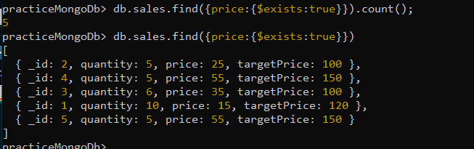
db.sales.find({price:{$exists:true}})

Slide 58
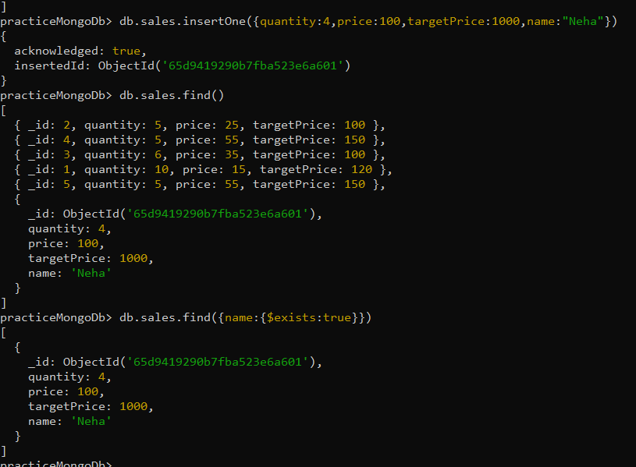

Slide 59
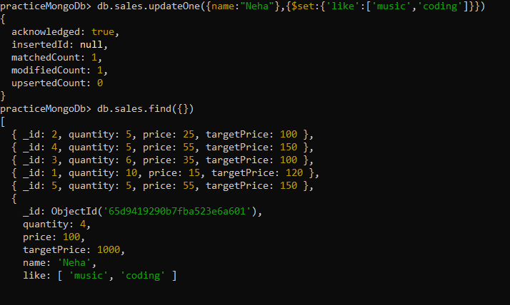
db.sales.find({like:{$size:2}}) //array size

Slide 60
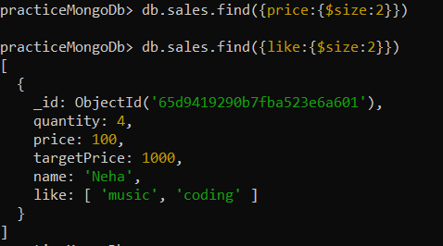

Slide 61
Projection
db.collection.find({}, { field1: 1, field2: 1 })
To include specific fields, use projection with a value of 1 for the fields you want.
To exclude fields, use projection with a value of 0 for the fields you want to exclude.
You cannot include and exclude fields simultaneously in the same query projection.
** By default all are included but if we want to remove some field just pass 0 to for it and by default id will be printed .
Thapa Technical
SUBSCRIBE
https://thapatechnical.shop

Slide 62
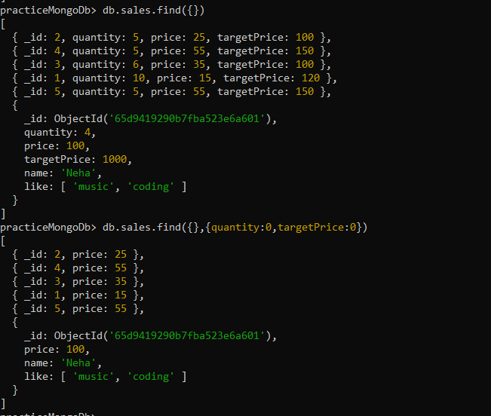

Slide 63
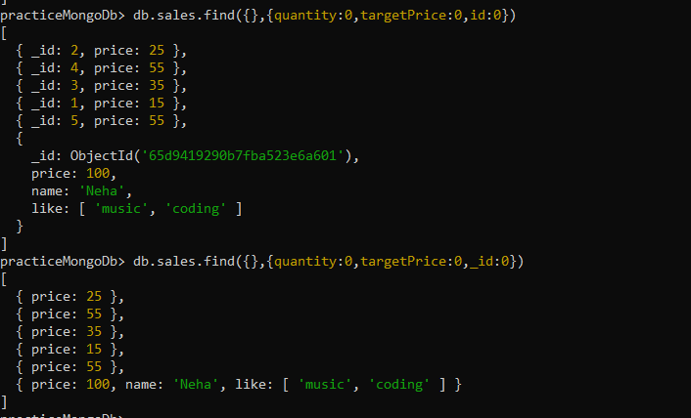

Slide 64
You can either go with inclusive or exclusive project , if all 0 are defined then no need to define for any field , if all 1 are defined then automatically others fields are consider 0 . *** _id will always be printed so if you don’t need to just mention _id:0 .

Slide 65
Embedded Documents (Nested Json)
Query documents inside embedded documents using dot notation.
db.collection.find({ “parent.child”: value })
Thapa Technical
SUBSCRIBE
https://thapatechnical.shop

Slide 66
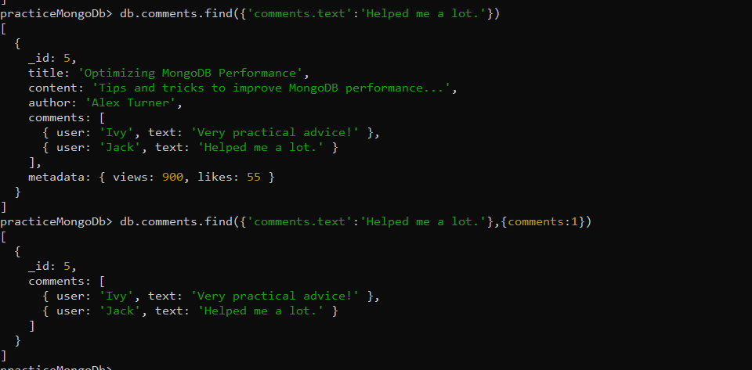

Slide 67
$all vs $elemMatch (ARRAY)
The $all operator selects the documents where the value of a field is an array that contains all the specified elements.
( all the elements of an array)
{ <field>: { $all: [ <value1> , <value2> ... ] } }
The $elemMatch operator matches documents that contain an array field with
at least one element that matches all the specified query criteria.
(an element)
{ <field>: { $elemMatch: { <query1>, <query2>, ... } } }
Thapa Technical
SUBSCRIBE
https://thapatechnical.shop

Slide 68
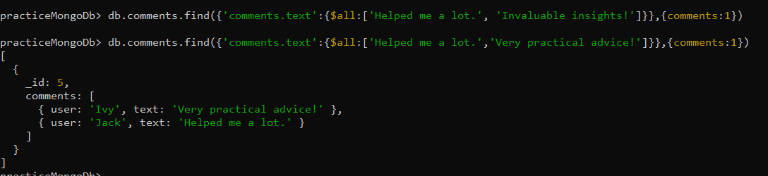
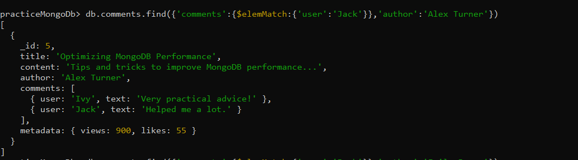

Slide 69
Update Operations in MongoDB
updateOne() and updateMany()
Removing and renaming fields Adding, removing items from array
Updating embedded documents
Thapa Technical
SUBSCRIBE
https://thapatechnical.shop

Slide 70
updateOne() and updateMany()
db.collectionName.updateOne(
{ filter },
{ $set: { existingField: newValue, newField: "new value", // ... }, }
);
db.collectionName.updateMany(
{ filter },
{ $set: { existingField: newValue, // ... }, }
);
Thapa Technical
SUBSCRIBE
https://thapatechnical.shop

Slide 71
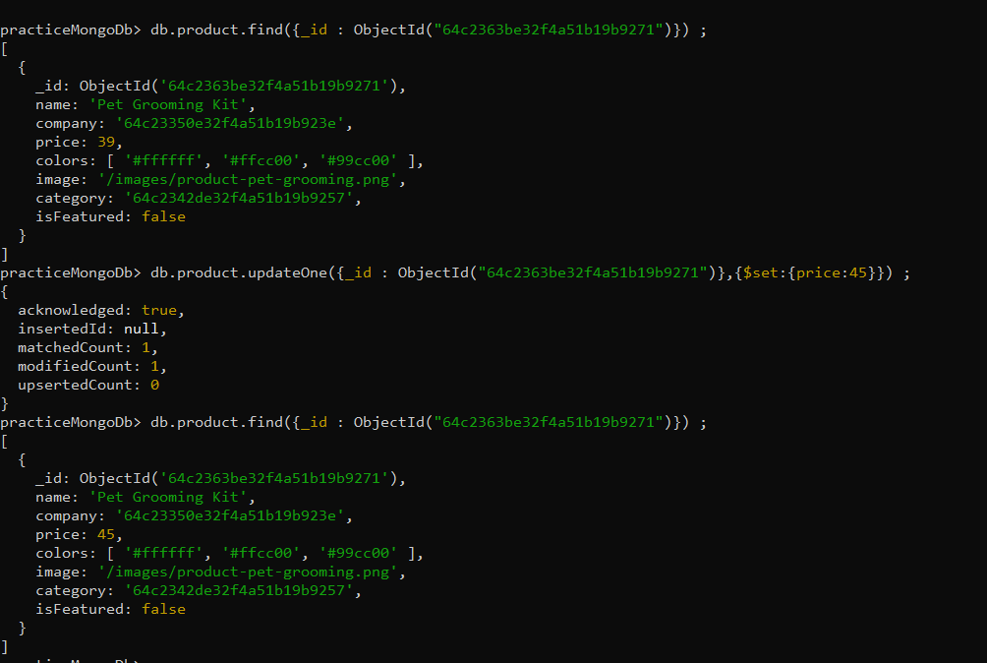
//? Update the price value = 45 in a products collections, where the _id = ObjectId("64c2363be32f4a51b19b9271")

Slide 72
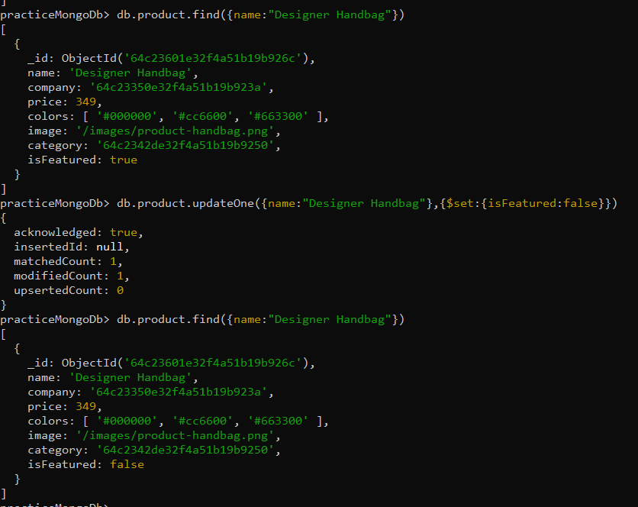
//? Update the isFeatures value = false in a products collections, where the name = Designer Handbag

Slide 73
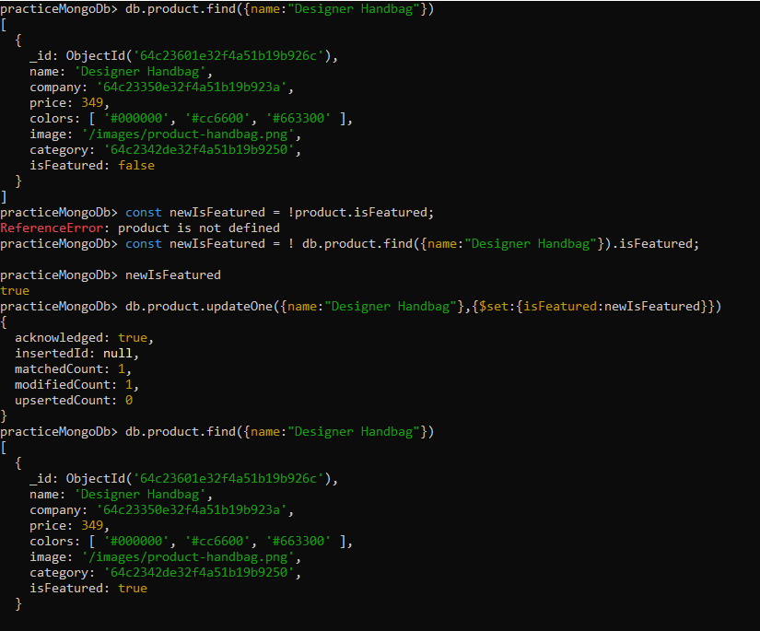
toggle

Slide 74
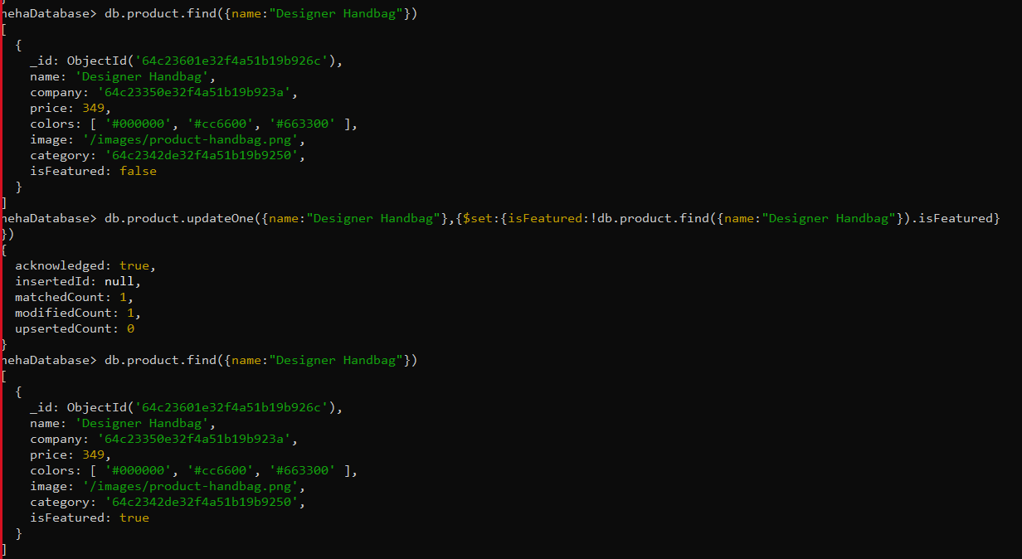

Slide 75
Removing and Renaming Fields
db.collectionName.updateOne( { filter }, { $unset: { fieldName: 1 } } );
db.product.updateMany({price:123},{$unset:{isFeature:1}})
db.collectionName.updateOne(
{ filter },
{ $rename: { oldFieldName: "newFieldName" } }
);
db.product.updateMany({price:123},
{$rename:{'isFeatured':'isFeature'}})
Thapa Technical
SUBSCRIBE
https://thapatechnical.shop

Slide 76
db.product.updateMany({},{$unset:{image:1}})
db.product.updateMany({},{$set:{image:"/png"}})
db.product.updateMany({},{$rename:{'isFeatured':'Feature'}})

Slide 77
Updating arrays and Embedded Documents
db.collectionName.updateOne(
{ filter },
{ $push: { arrayField: "new element" } }
);
db.collectionName.updateOne(
{ filter },
{ $pop: { arrayField: value } }
);
db.collectionName.updateOne(
{ filter },
{ $set: { "arrayField.$.text": "Updated text" } }
);
Thapa Technical
SUBSCRIBE
https://thapatechnical.shop

Slide 78
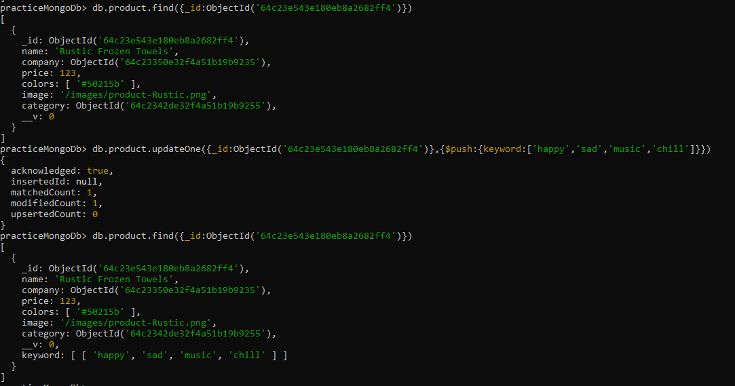

Slide 79
Delete Operations in MongoDB
db.collectionName.deleteOne({ filter });
db.sales.deleteMany({ price: 55 });
Thapa Technical
SUBSCRIBE
https://thapatechnical.shop

Slide 80
MONGODB
DELETEONE
DeleteOne
Before
After
[
db.Students.deleteOne(
{
name: “Binamra"
}
);
{
[
name: "Vinod", age: 29,
{
name: "Vinod", age: 29,
},
{
}
name: “Binamra",
age: 20,
]
}
]
Thapa Technical
SUBSCRIBE
https://thapatechnical.shop

Slide 81
Indexes in MongoDB
What are Indexes?
Benefits of Indexes Managing Indexes
Unique, Text Index
When not to use Indexes?
Thapa Technical
SUBSCRIBE
https://thapatechnical.shop

Slide 82
What are Indexes?
Indexes are specialized data structures that optimize data retrieval speed in
MongoDB.
Indexes store a fraction of data in a more searchable format. They enable MongoDB to locate data faster during queries.
Indexes are separate from collections and multiple indexes can exist per collection.
Thapa Technical
SUBSCRIBE
https://thapatechnical.shop

Slide 83
Benefits of Indexes
Faster Querying: Indexes drastically accelerate data retrieval, particularly for large collections.
Efficient Sorting: Indexes facilitate rapid sorting based on specific fields.
Improved Aggregation: Aggregation operations become more efficient with optimized indexes.
Indexing on Multiple Fields: Complex queries can be executed efficiently by utilizing multiple fields in indexes.
Thapa Technical
SUBSCRIBE
https://thapatechnical.shop

Slide 84
explain()
Use explain() method to understand query execution in detail.
db.products.find({ name: 'Air Fryer' }).explain();
db.products.find({ name: 'Air Fryer' }).explain("executionStats");
Use it to measure the time taken to execute a query.
Thapa Technical
SUBSCRIBE
https://thapatechnical.shop

Slide 85
Managing Indexes
db.products.createIndex({ field: 1 });
(1) for storing indexes in ascending order.
(-1) for storing indexes in descending order.
db.collection.getIndexes();
_id is a default index.
db.collection.dropIndex({ field: 1 });
db.collection.dropIndex(“index_name”);
Thapa Technical
SUBSCRIBE
https://thapatechnical.shop

Slide 86
Unique and Text Indexes
db.collection.createIndex({ field: 1 }, { unique: true });
db.collection.createIndex({ field: "text" });
db.collection.find({ $text: { $search: "keyword" } });
Searching using index is faster than $regex searching.
db.products.find({ field: { $regex: "air" } })
Thapa Technical
SUBSCRIBE
https://thapatechnical.shop

Slide 87







When not to use Indexes?
Indexes on Rarely
Used Fields
Indexing Small
Collections
Balancing Act
Indexing fields that are seldom used in queries can consume unnecessary space and resources.
Indexing requires disk space and memory. Overindexing can lead to resource strain and impact overall performance.
In smaller collections, the cost of index maintenance might outweigh the benefits gained from querying.
Thapa Technical
SUBSCRIBE
https://thapatechnical.shop

Slide 88
Aggregation in MongoDB
What is Aggregation?
Thapa Technical
SUBSCRIBE
https://thapatechnical.shop

Slide 89
What is Aggregation?
Definition: Aggregation is the process of performing transformations on documents
and combining them to produce computed results.
Pipeline Stages: Aggregations consist of multiple pipeline stages, each performing a specific operation on the input data.
Benefits
Aggregating Data: Complex calculations and operations are possible.
Advanced Transformations: Data can be combined, reshaped, and computed for insights. Efficient Processing: Aggregation handles large datasets efficiently.
Thapa Technical
SUBSCRIBE
https://thapatechnical.shop

Slide 90
$match
The $match stage is similar to the query used as the first argument in .find(). It filters documents based on specified conditions.
Syntax
{ $match: { <query> } }
Example
db.products.aggregate([
{ $match: { company: "64c23350e32f4a51b19b9235" } }
]);
Thapa Technical
SUBSCRIBE
https://thapatechnical.shop

Slide 91
$group
The $group stage groups documents by specified fields and performs aggregate operations on grouped data
{
$group:
{
_id: <expression>, // Group key
<field1>: { <accumulator1> : <expression1> },
...
}
}
db.products.aggregate([
{ $group: { _id: { comp: "$company" }, totalProducts: { $sum: 1 } } }
]);
This groups products by company and calculates the total number of products for each company.
Thapa Technical
SUBSCRIBE
https://thapatechnical.shop

Slide 92
$group (continued)
The $group stage can calculate various aggregate values within grouped data.
db.products.aggregate([
{ $group: {
_id: { comp: "$company" }, totalPrice: { $sum: "$price" }, totalProducts: { $sum: 1 },
averagePrice: { $avg: "$price" }
} }
]);
Thapa Technical
SUBSCRIBE
https://thapatechnical.shop

Slide 93
Group is a function to group field on a specific field only and we can perform sum operation on it too to get a cumulative value . Mostly used for statistics. db.product.aggregate({$group:{_id:{name:"$name"},totalSum:{$sum:'$price'}}})

Slide 94
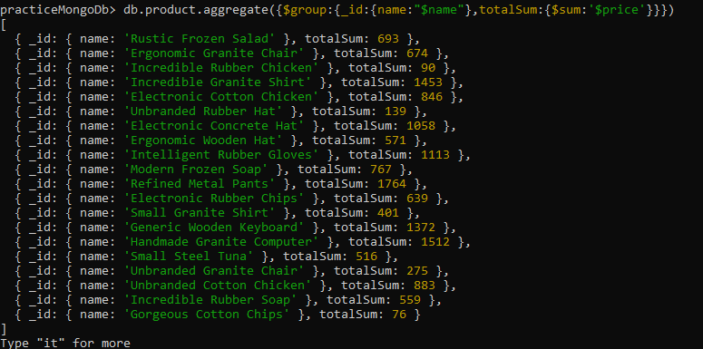
db.product.aggregate({$group:{_id:{name:"$name"},totalSum:{$sum:'$price'}}})

Slide 95
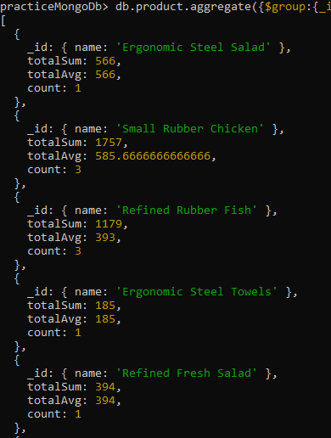
db.product.aggregate
({$group:
{_id:{name:"$name"},
totalSum:{$sum:'$price'},
totalAvg:{$avg:'$price'},
count:{$count:{}}}}
).pretty()

Slide 96
$sort
{ $sort: { <field>: <order> } }
db.products.aggregate([
{ $sort: { totalProducts: 1 } }
]);
Thapa Technical
SUBSCRIBE
https://thapatechnical.shop

Slide 97
$project
The $project stage reshapes documents, includes or excludes fields, and performs operations on fields.
{ $project: { <field1>: <expression1>, ... } }
db.products.aggregate([
{ $project: { name: 1, discountedPrice: { $subtract: ["$price", 5] } } }
]);
Projects the name field and calculates a discountedPrice field by subtracting 5 from the price.
$sum, $subtract, $multiply, $avg, etc. are types of expression operator.
Thapa Technical
SUBSCRIBE
https://thapatechnical.shop

Slide 98
$push
The $push stage adds elements to an array field within documents.
{ $push: <expression> }
db.products.aggregate([
{ $group: { _id: { company: "$company" }, products: { $push: "$name" } } }
]);
Thapa Technical
SUBSCRIBE
https://thapatechnical.shop

Slide 99
$unwind
The $unwind stage deconstructs an array field and produces multiple documents.
{ $unwind: <array> }
db.products.aggregate([
{ $unwind: "$colors" },
{ $group: { _id: { company: "$company" }, products: { $push: "$colors" } } }
]);
Deconstructs the colors array field, groups products by company, and creates an array of colors for each company.
Thapa Technical
SUBSCRIBE
https://thapatechnical.shop

Slide 100
$addToSet
The $addToSet stage adds elements to an array field while preventing duplicates.
db.products.aggregate([
{ $unwind: "$colors" },
{ $group: {
_id: { company: "$company" },
products: { $addToSet: "$colors" }
} }
])
Groups products by company and creates an array of unique colors for each company.
Thapa Technical
SUBSCRIBE
https://thapatechnical.shop

Slide 101
$size
The $size stage calculates the length of an array field.
{ $size: <array> }
db.products.aggregate([
{ $project: { name: 1, numberOfColors: { $size: "$colors" } } }
]);
Projects the name field and calculates the number of colors in the colors array.
Thapa Technical
SUBSCRIBE
https://thapatechnical.shop

Slide 102
$limit and $skip
The $limit and $skip stages are useful for pagination, limiting, and skipping results.
{ $limit: <positive integer> }
db.products.aggregate([
{ $skip: 10 },
{ $limit: 10 }
]);
Thapa Technical
SUBSCRIBE
https://thapatechnical.shop

Slide 103
$filter
The $filter stage filters elements of an array based on specified conditions.
{
$project: {
<field>: {
$filter: {
input: '$<array>’,
as: '<variable>’
cond: <expression>
}
}
}
}
Thapa Technical
SUBSCRIBE
https://thapatechnical.shop

Slide 104
$addFields
The $addFields stage adds new fields to documents in a cleaner way compared to $project.
{ $addFields: { <field1>: <expression1>, ... } }
db.products.aggregate([
{ $addFields: { discountedPrice: { $subtract: ["$price", 5] } } }
]);
Thapa Technical
SUBSCRIBE
https://thapatechnical.shop

Slide 105
Introduction to MongoDB Atlas
MongoDB Atlas is MongoDB's fully managed cloud database service.
It offers an easy way to deploy, manage, and scale MongoDB databases in the cloud.
Atlas eliminates the need for manual setup and maintenance, allowing developers to focus on their applications.
It provides automated scaling options to accommodate growing workloads.
Atlas supports global clusters, enabling databases to be deployed across multiple regions for better data availability and reduced latency.
Thapa Technical
SUBSCRIBE
https://thapatechnical.shop

Slide 106
MongoDB Atlas
Setup
Thapa Technical
SUBSCRIBE
https://thapatechnical.shop

Slide 107
Working with MongoDB Compass
Thapa Technical
SUBSCRIBE
https://thapatechnical.shop

Slide 108
Working with MongoDB Drivers
Introduction to MongoDB Drivers Working with Node.js MongoDB Drivers
Thapa Technical
SUBSCRIBE
https://thapatechnical.shop

Slide 109
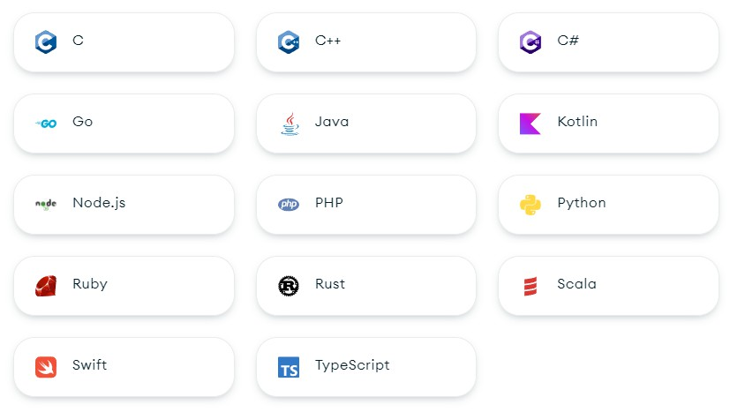
Introduction to MongoDB Drivers
Software libraries that allow applications to interact with MongoDB databases.
MongoDB offers official and community- supported drivers for various programming languages.
Drivers provide APIs tailored to specific
programming languages.
https://www.mongodb.com/docs/drivers/
Thapa Technical
SUBSCRIBE
https://thapatechnical.shop

Slide 110
How MongoDB Works?
Backend (Drivers)
Frontend
Database
MongoDB Server
WiredTiger or MMAPV1 (❌)
Node.js
Storage Engine
PHP
HTML, CSS, JS
Read & Write Data files
Java
React.js, Next.js
Python
Thapa Technical
SUBSCRIBE
https://thapatechnical.shop

Slide 111
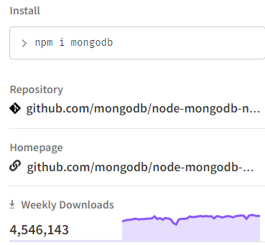
Getting Started with Node.js MongoDB Driver
Download and install Node.js from official Node.js website.
Create a node.js project using npm init –y
Install mongodb driver using npm install mongodb
https://www.npmjs.com/package/mongodb
Create a connection with MongoDB database and start working with it.
Thapa Technical
SUBSCRIBE
https://thapatechnical.shop

Slide 112
Getting Started with Node.js MongoDB Driver
Connect to MongoDB Server: Use the
MongoDB server.
MongoClient
class and a valid URI to establish a connection to the
Select a Database: Access a specific database using the
client.db(databaseName)
method.
Access a Collection: Retrieve a collection reference using the method.
db.collection(collectionName)
Perform Operations: Perform CRUD operations like querying, inserting, updating, and deleting documents within the collection.
Close Connection: Safely close the connection using the method when done
client.close()
Thapa Technical
SUBSCRIBE
https://thapatechnical.shop

Slide 113
Working with Mongoose
Introduction to MongoDB Drivers
Working with Node.js MongoDB Drivers
Thapa Technical
SUBSCRIBE
https://thapatechnical.shop

Slide 114
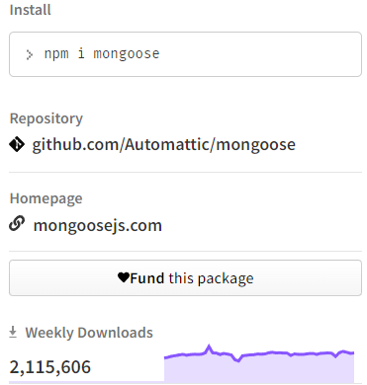
Getting Started with Node.js MongoDB Driver
It's an Object Data Modeling (ODM) library for MongoDB and Node.js.
It makes MongoDB interaction more straightforward and organized.
It provides a structured, schema-based data
modeling approach.
Thapa Technical
SUBSCRIBE
https://thapatechnical.shop

Slide 115












Why Mongoose instead of official driver?
Structured Schemas
Validation
Relationships
Middleware
Complex Queries
Mongoose lets you define your data's structure using schemas which makes it easier to understand your database structure and work with it.
Mongoose provides built-in validation to ensure validity before saving it to database
MongoDB doesn’t provide relations itself. So, Mongoose helps to replicate relations in MongoDB and helps us to relate schemas with each other easily (one-to- one, one-to-many, etc.)
Mongoose offers running custom functions before or after certain operations which can be useful in many cases.
MongoDB helps to write complex queries, aggregations, etc. with simpler syntax to help us to work on projects easily
Thapa Technical
SUBSCRIBE
https://thapatechnical.shop

